Slide 1
Managing an International Project (Outside the UK)
Part 1

Slide 2
Objectives
Understanding of difficulties within an international project
Analyse the causes that make an international project to fail
Look at cultural frameworks in planning international projects
The overall management of an international project

Slide 3

What is an international project management?
International project management Is the management of projects internationally or across borders and cultures

Slide 4
Main purposes of an international project
Explore new geographical opportunities
Increase efficiency
Increase market share and global power
Gain access to new (or unique) resources
Reduce Risk

Slide 5
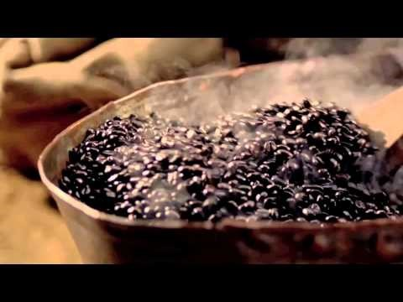

Slide 6

STARBUCKS COFFEE
Worlds largest Coffee House
Started in Seattle, USA
Now has over 24,000 stores in 70 countries

Slide 7
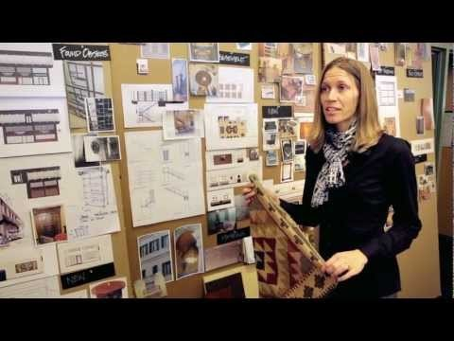

Slide 8
Challenges Facing International Projects
Differences in cultures
Extensive travel can have an impact on the individual
Communication between different international work teams
Changes in economic, social and political environments
Risk intensity

Slide 9
Why Do International Projects Fail?
Failure to establish trust between co-workers
Failure to examine and prioritize goals
Bad selection of partners
No clarity of operational objectives
No consideration of culture
Failure in monitoring management
Headquarters not retaining commitment and support
Executive and management team is not effective
Goals and pacing of schedule unrealistic

Slide 10
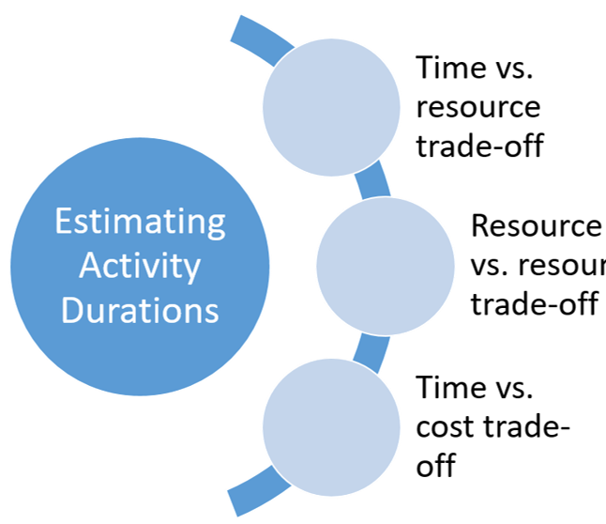
The Planning Process
The Challenges:
Minimise the project duration
Minimize the resource availability cost
Maximize quality

Slide 11
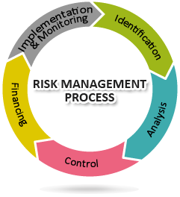
Risk Management Process
What is a Risk Management Process?
The steps involved in identifying, monitoring and controlling risk. Each risk can then be identified, what impact it will have and what action can be taken to stop it.
When do I use a Risk Process?
This should always be used. A project may face risks regularly and by putting this process in place they can be monitored and controlled.

Slide 12

Effective Communication
Face-to-face is the best
Don’t reply immediately to negative emails
‘Active listening’ is key
Paraphrasing can help enormously
Give and ask for feedback
Take into consideration time for written responses

Slide 13
International Differences
Geography​
Climate
seasonal difference
Legal/ Political​
Stability of country​
Laws​
Government
Infrastructure​
Telecommunications
Transport​ation
Power grids​
Education​
International Differences
Legal/ Political​
Stability of country​
Laws​
Government
Culture​
Customs
Religion
Language
Security​
Instability​
Local crime

Slide 14
International Differences
Security​
Instability​
Local crime
Economic​
Payments​
Currency
Exchange rate​
Local work force
Infrastructure​
Telecommunications
Transport​ation
Power grids​
Education​
Culture​
Customs
Religion
Language
Geography​
Climate
seasonal difference

Slide 15

CULTURAL DIFFERENCES
Religion
Language
Culture
Values
Customs
Notes:
SAGE KATHRIN COSTER 2010

Slide 16
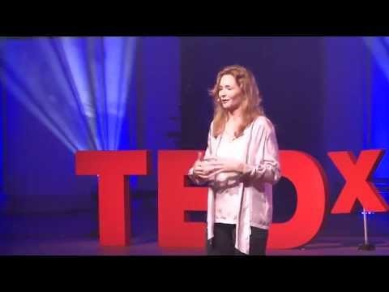

Slide 17
Becoming an effective Intercultural Worker
Adaptation skills
Don’t think of owns culture to be superior
Understand “culture”
Extensive knowledge of the host country
Communication skills
Sociability and Interpersonal and relationship-building skills
International meetings contributions
High level of commitment

Slide 18
Cross cultural training
Language Training
Intercultural trainer from host country
Education in local culture, art, history and politics
Training in county cultural standing (power, individualism, collectivism and masculinity vs feminism).
Prepare employees for a cultural shock.

Slide 19
Overview
Main causes of failures.
Environmental factors
Cultural factors
How to reduce chance of failure of an international project

Slide 20
References

Slide 22
Managing an International Project (Outside the UK)
(PART 2)

Slide 23
Objectives
Recap of Part 1
Hofstede Culture Dimension
Case study

Slide 24
Hofstede Culture Dimension
5 Key Differences
Power Distance
Individualism vs Collectivism - Individualism
Masculinity
Uncertainty of avoidance
Long-Term Orientation

Slide 25
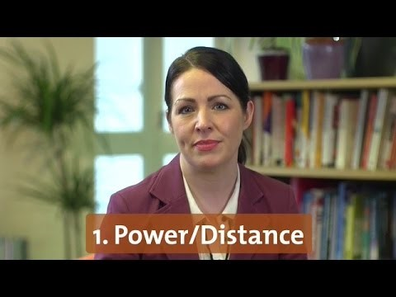

Slide 26
Power Distance
Degree in which less powerful people, accept and expect that power is distributed unevenly.
Also how society deals with inequality.
Large degree – Accepts hierarchical order where everybody has a place needs no further justification.
Low degree - People wish to equalise power distribution and want reasoning for inequalities of power

Slide 27
Individualism
Individualism - Wanting of a loose knit society where individuals are expected to take care of only themselves and their family.
Collectivism - wanting of a tightly-knit society where relatives and group members will take care of each other for unquestioning loyalty.
This is reflected in whether they refer to themselves as “I” or “we”

Slide 28
Masculinity
Masculinity - preference for achievement, heroism, assertiveness and material rewards for success altogether more competitive.
Femininity - preference for cooperation, modesty, caring for the weak and quality of life.
Also known as a "tough versus tender" cultures.

Slide 29
Uncertainty of avoidance
Degree to which society feels uncomfortable with uncertainty and ambiguity.
How a society deals with the future being unknown.
Should we try to control the future or just let it happen?
Large degree - rigid codes of belief and behaviour and intolerant of unorthodox behaviour and ideas.
Low degree - more relaxed attitude where practice counts more than principles.

Slide 30
Long-term Orientation
Challenges of the present and future can be prioritised differently
Low degree - Prefer to maintain time-honoured traditions and norms while viewing societal change with suspicion.
Large degree - Take a pragmatic approach, encouraging thrift and efforts in modern education as a way to prepare for the future.
Can be related to as " (short term) normative versus (long term) pragmatic" (PRA).

Slide 31
Hofstede and Management

Slide 32
International project Case Study

Slide 33
References

